Slide 1

MID-TERM PROJECT
GROUP 6
Chau Trinh, Eirlys Vo, and Sandy Chun Domingo

Slide 2
Introduction
Business Problem/Question
How do the promotions in different display/mail locations (ex: front page feature in mail, store rear in display) impact customer purchase behavior?
Campaign Types Effect on Sales Value
Hypothesis: Products placed at certain display locations, when combined with coupon promotions, will result in the highest number of purchases compared to other display locations.
Hypothesis: Customer is likely to redeem coupons if products are placed at interior page feature in mail.
Comparisons of total sales value between Display and Mailer locations

Slide 3
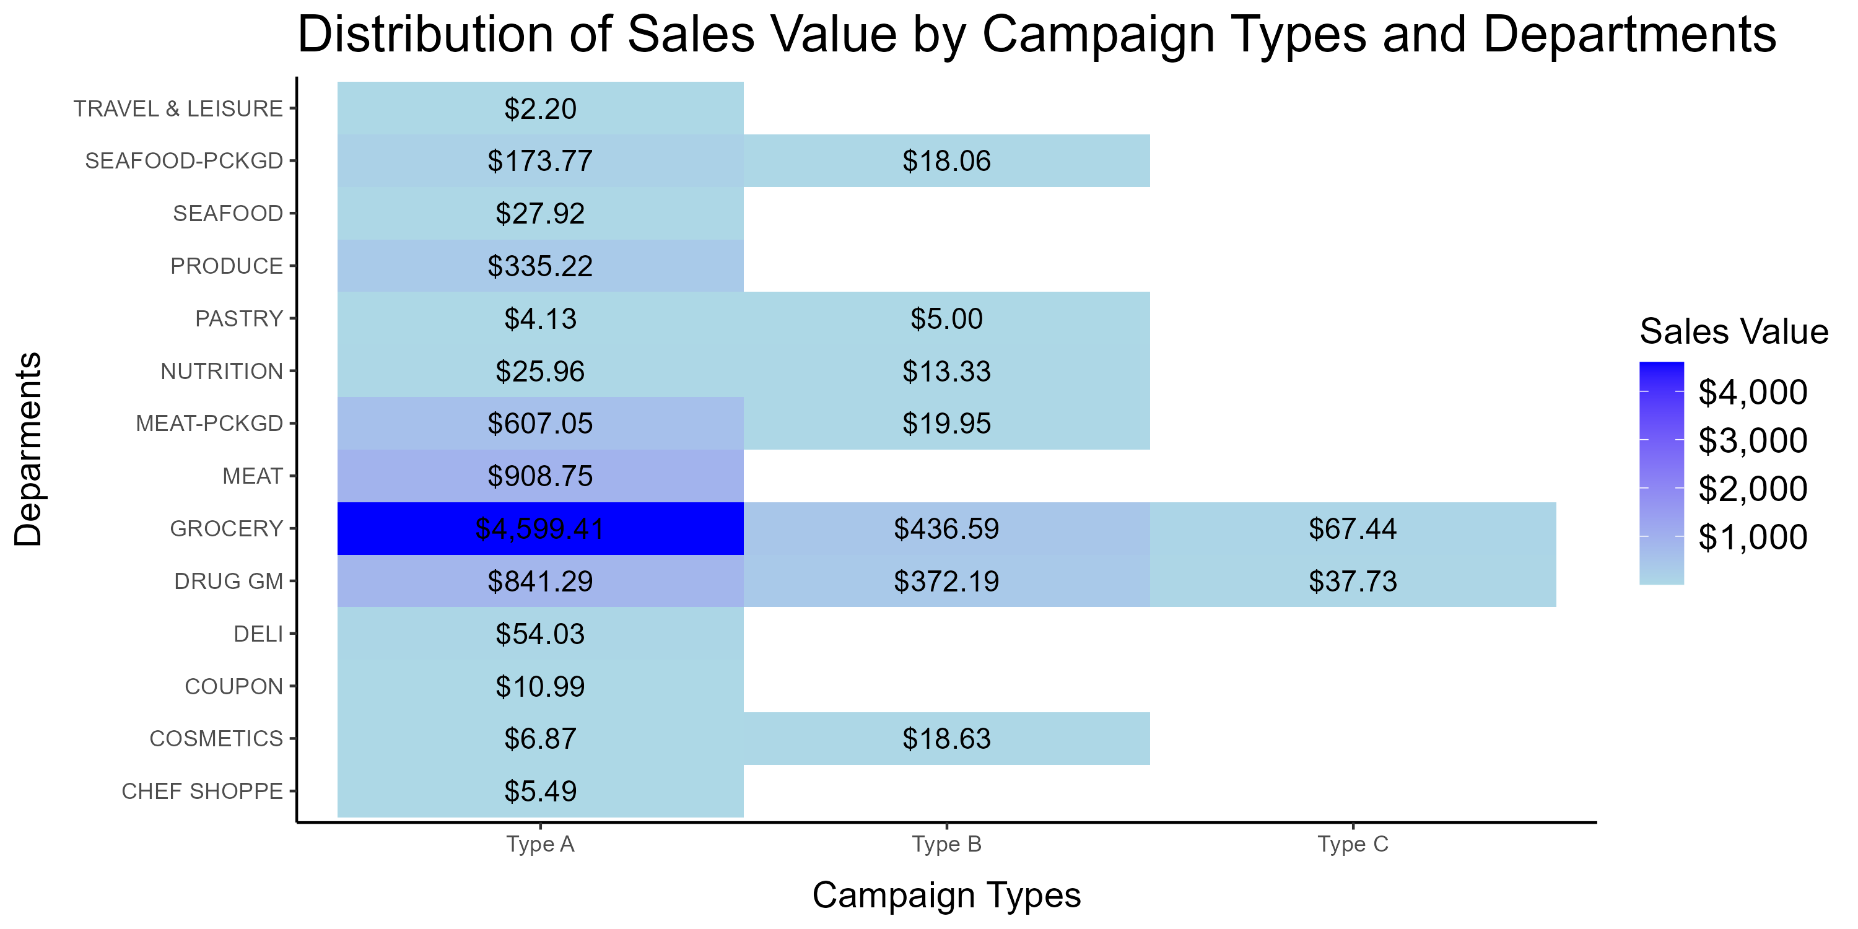
Campaign Types Effect on Sales Value
Analysis Overview
Investigated coupon campaign types' effects on redemption counts and total sales value.
Key Findings
Campaign Type A:
Outperformed others in both redemption counts and sales value.
Requires further analysis on:
Best-suited products
Time frame factors
Sales Distribution Insights
Grocery Department:
Led in sales across all campaign types due to essential nature.
Type A Campaign:
Highly effective;
Potential strategies to enhance underperforming departments
Could be model campaign in the future
Notes:
Campaign Type A coming far ahead of others campaigns in both redemption count and total sales value. This implies how strong Campaign Type A was in triggering engagement from customers with the products having coupons.
With this in mind, we further looked into the total sales value by departments that each campaign brought in.
The Grocery department stays on top of total sales value regardless of campaign types. This can be explained by being daily necessities. In the following EDA, we can omit Grocery department to see how other departments were doing.
Type A campaign has consistently driven the highest sales across all departments. This suggests that the promotional strategy used in Type A is highly effective and has broad appeal. This superior performance of Type A highlights its potential as a model for future campaigns.
Type B and Type C shows no sales in several departments, which might indicate that the promotions are not well-targeted or appealing in certain categories.

Slide 4
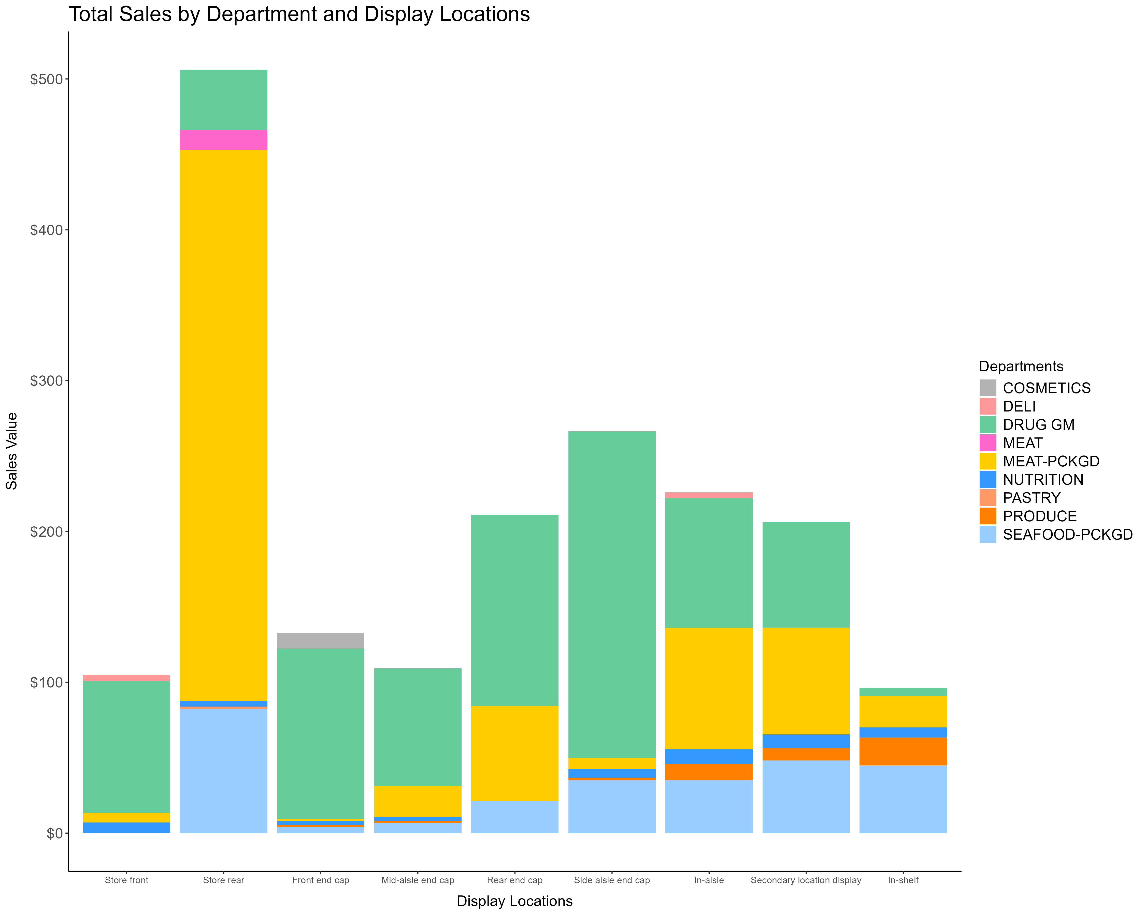
Display Location Analysis
Key Findings
Sales Plot: Shows actual total sales values by department (excluding Grocery).
Top Performers:
Drug GM had the highest sales, followed by Meat Packaged, indicating that coupons boost purchases.
Top Location:
Store rear exhibited the most significant total sales value across all departments
Conclusion
Display Impact:
Locations greatly influence sales, especially for packaged goods.
Notes:
The location Store rear turned out to have extraordinarily the highest total sales value across departments. This pattern could suggest that customers tend to purchase products being displayed at store rear, especially MEAT-PCKGD.
COSMETICS department has explicit sales value at Front end cap but not other locations.This could be due to low visibility at other spots.
The products dataset has 32 unique departments, but only 9 departments were shown in above graph with transactions having coupon redemption. Regork might want to look examine further how display locations could affect the sales value if coupons are issued for the other departments.

Slide 5
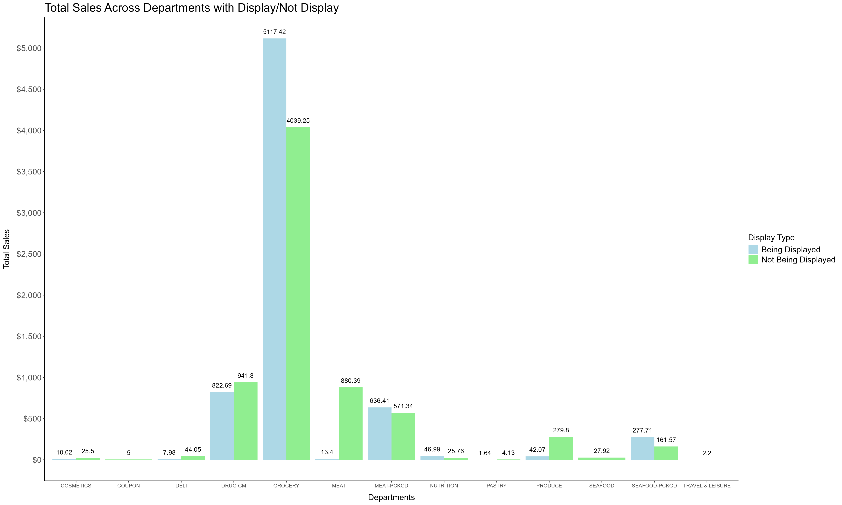
Display location analysis
Key Findings
Top Performers:
Despite not being actively displayed, the Grocery department continued to lead in total sales value
Notably, the MEAT department, which likely includes fresh meat, appeared to be purchased primarily when not displayed
Display Impact:
TRAVEL & LEISURE department only saw purchases when its products were not displayed
=> A unique purchasing behavior in this category
Notes:
Despite not being actively displayed, the Grocery department continued to lead in total sales value, followed by the Drug GM department. Notably, the MEAT department, which likely includes fresh meat, appeared to be purchased primarily when not displayed.
Another observation is that the TRAVEL & LEISURE department only saw purchases when its products were not displayed, suggesting a unique purchasing behavior in this category.

Slide 6
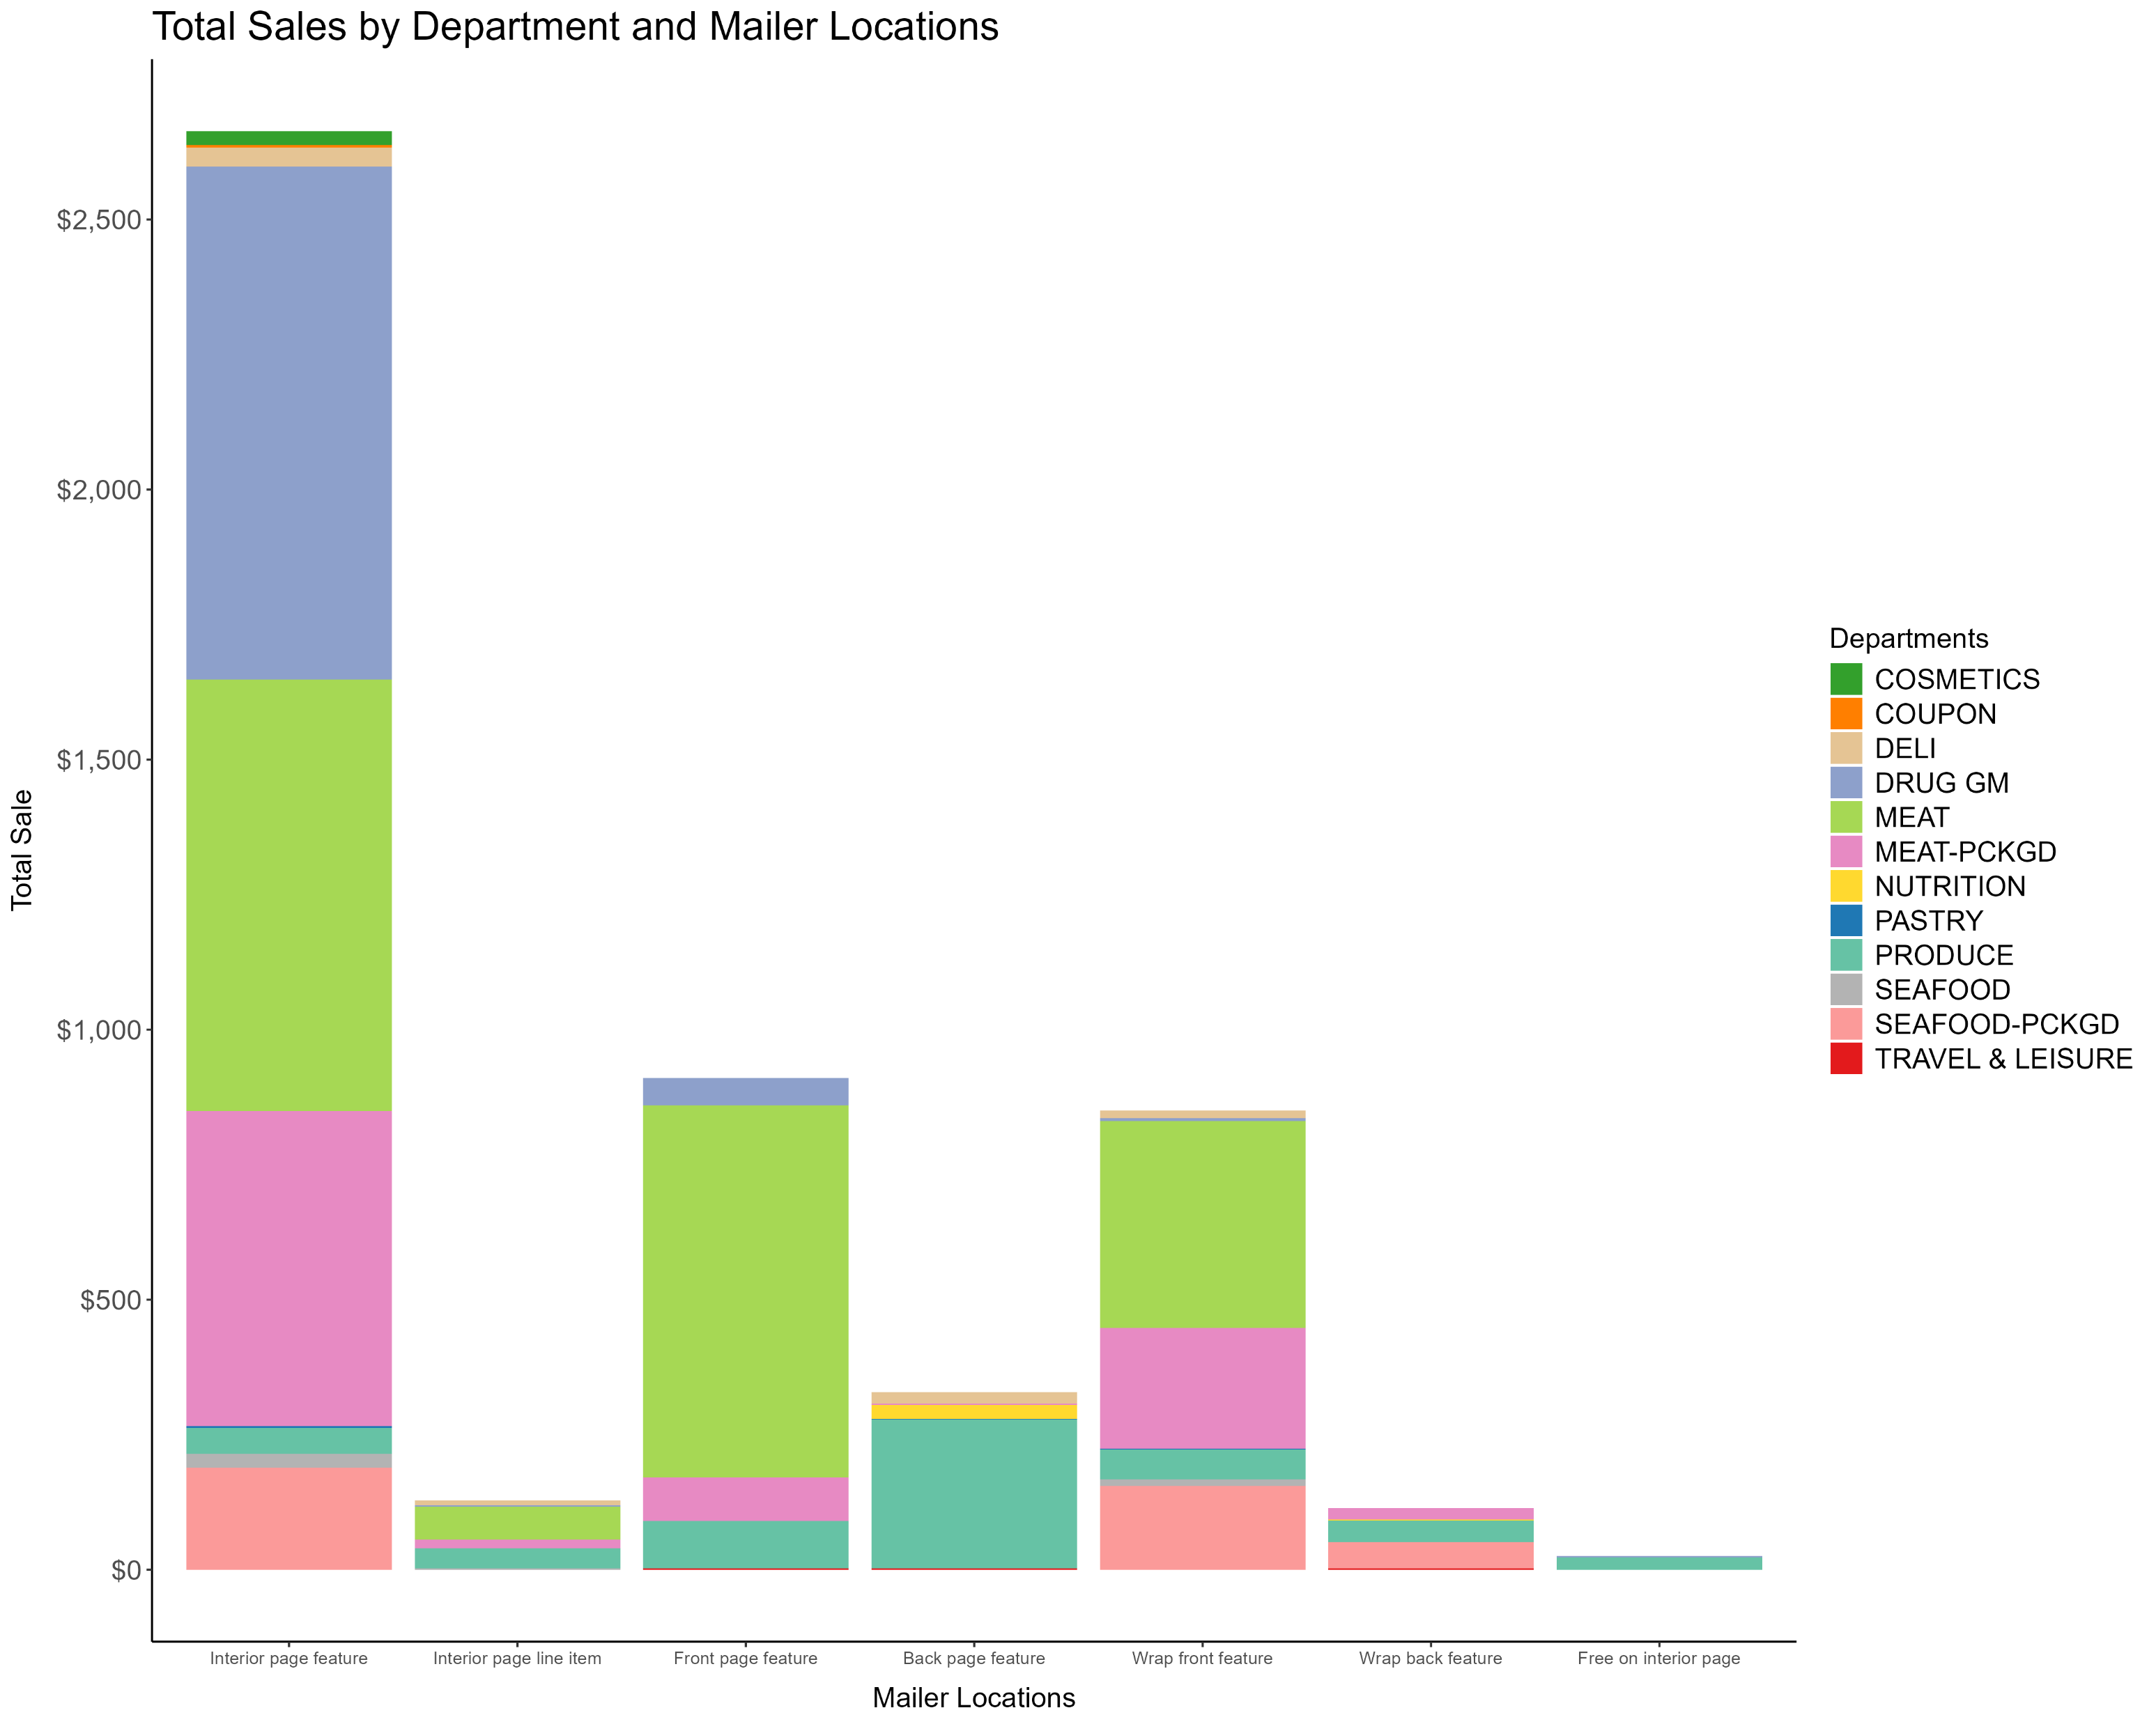
Impact of Mailer Locations on Sales Value
Key Findings
More departments were represented
Top Sales Locations:
DRUG GM now concentrated its sales value primarily on the Interior page feature
TRAVEL & LEISURE department, which wasn’t seen in the display locations analysis, showed a small sales value across three different mailer locations
Conclusion
Strategic placement in mailers boosts sales value rates
Notes:
With mailer locations, more departments were represented compared to display locations, but MEAT and MEAT-PCKGD still dominated in total sales value across various locations. Interestingly, DRUG GM now concentrated its sales value primarily on the Interior page feature, unlike the broader distribution seen in display locations.
As noted earlier, while the products dataset includes 32 unique departments, only 13 are reflected in this analysis. Regork may want to explore opportunities to promote the remaining departments using coupons in mailer locations.
The TRAVEL & LEISURE department, which wasn’t seen in the display locations analysis, showed a small sales value across three different mailer locations. It may be worth conducting a survey to determine whether increasing this department’s presence in mailers, particularly in the Interior page feature, could boost its sales value.

Slide 7
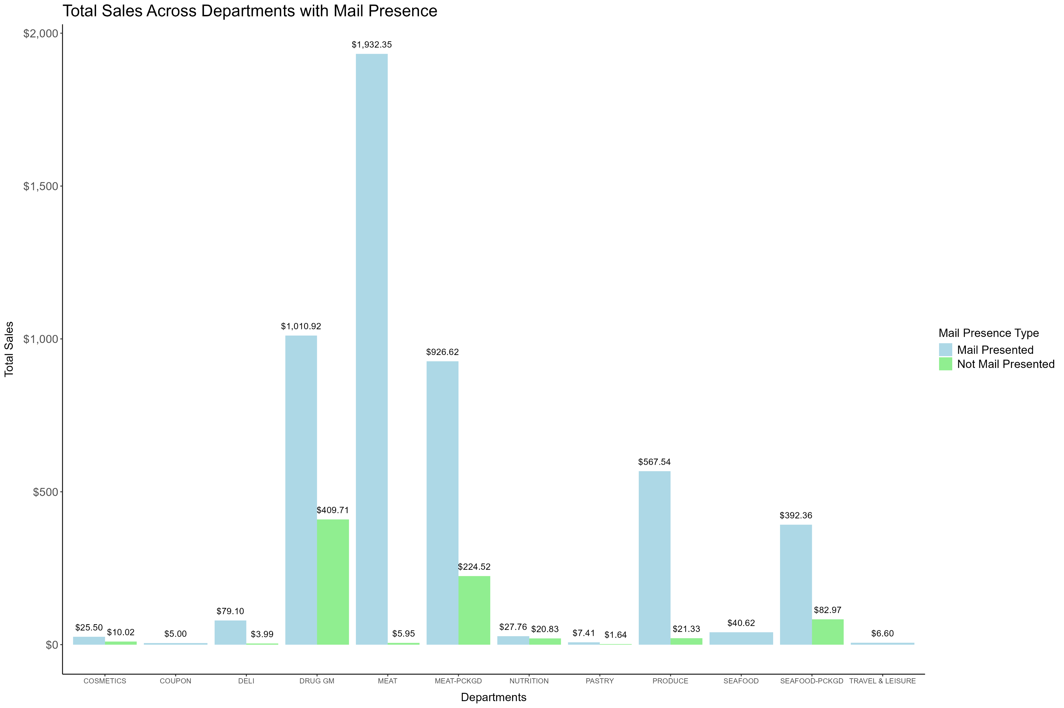
Impact of Mailer Locations on Sales Value
Key Findings
No department generated higher sales value without being featured in the mail
COUPON and TRAVEL & LEISURE were the only two departments that saw no sales when not included in mail promotion
MEAT department showed a sales approximately 200 times higher than not being presented in mail
Conclusion
Display Impact:
Being included in mail promotion greatly influenced sales

Slide 8
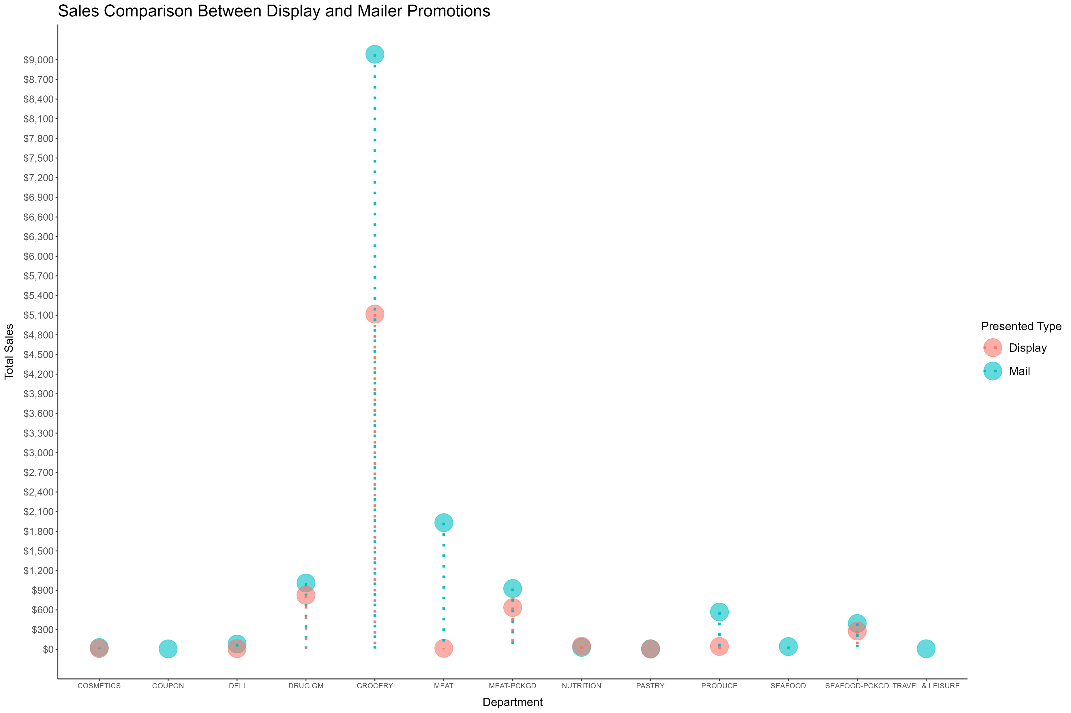
Display vs. Mailer promotion
Data Overview:
Total sales summarized by departments for both promotions.
Key Findings:
GROCERY department remained the top performer across all promotion types
Mail promotions drive higher sales overall.
Conclusion: Customers tend to purchase and redeem coupons more frequently when they see promotions in the mail, indicating a shift in consumer behavior toward online shopping.

Slide 9
Summary
Analyzed coupon campaigns, display locations, and mailer promotions.
Key findings:
Campaign Type A boosted sales and engagement => Future campaign model
MEAT had significantly higher sales value when not displayed compared to when it was displayed
TRAVEL & LEISURE and DELI, which were not seen in the display location analysis, became more prominent when looking at the mailer view
Limitations
Future analysis should explore the impact of time frames on promotional campaigns and their sales performance.
Validation is needed to confirm that all transactions with discounts are redeemed coupons.
Approximately 2 million coupon redemptions lack transaction records; gathering more data could affect campaign sales insights.
Notes:
We have not yet considered the impact of time frames on these promotional campaigns. Future work should include an analysis of how the timing of promotions influences sales performance.
The assumption made at the beginning of the report, that all transactions with any discount are redeemed coupons, has yet to be confirmed. Further validation of this assumption is necessary to ensure the accuracy of the analysis.
There are approximately 2 million coupon redemptions without corresponding transaction records. Collecting more data on these redemptions could provide valuable insights and potentially affect the total sales value of the different campaign types.

